Slide 1
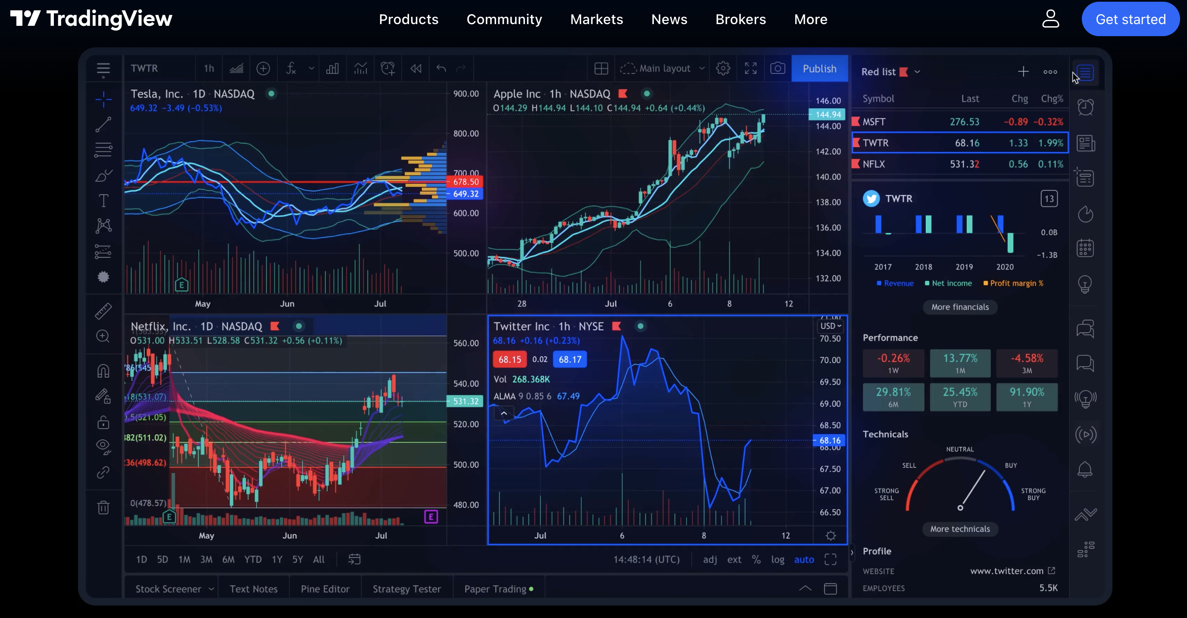
Data Science Assignment
Trader Performance vs
Market Sentiment
(Fear vs Greed)
Analyzing trader behavior and risk dynamics across Bitcoin sentiment regimes using Python, statistical testing, and Hyperliquid data
Python
Pandas
Seaborn
Statistical Analysis
January 2025

Slide 2
ASSIGNMENT CONTEXT
Problem Statement
& Objective
!
Our Objective
Analyze trader performance, risk behavior, and consistency across sentiment regimes to uncover regime-dependent patterns.
?
The Problem
Understanding how trader profitability and risk-taking differ under Fear vs Greed market conditions in the Bitcoin ecosystem.
Do traders perform better in certain sentiment regimes?
1
Quantify performance differences
How does risk behavior change with market sentiment?
2
Identify risk-taking patterns
Are performance patterns consistent across conditions?
3
Validate findings statistically
4
Extract actionable insights

Slide 3
DATA FOUNDATION
Datasets Used
Bitcoin Fear & Greed Index
Historical Trader Data
Daily Market Sentiment
Hyperliquid Perpetuals DEX
Daily sentiment classification ranging from Extreme Fear to Extreme Greed , providing a comprehensive view of market psychology.
Comprehensive trading activity from Hyperliquid , including trades, PnL, position sizes, and timestamps for detailed analysis.
Extreme Fear
0-24
Account identifiers & timestamps
Fear
25-49
Execution prices & trade sides
Greed
50-74
Position sizes & USD values
Extreme Greed
75-100
Closed PnL & realized returns
Source: Alternative.me (Feb 2018 - Present)
Source: Hyperliquid API (Real-time)
Data Processing Pipeline
Datasets merged in Python via timestamps. Cleaning: handle missing values, normalize PnL, create risk buckets, and align dates for analysis.

Slide 4
ANALYTICAL FRAMEWORK
Methodology Overview
1
Data Cleaning & Preprocessing
Handled missing values, removed outliers, standardized formats. Used pandas for alignment and normalization.
2
Merging Trades with Daily Sentiment
Joined trader data with Fear & Greed Index by date. Each trade labeled with sentiment regime for cross-sectional analysis.
3
Feature Engineering
Created derived metrics: PnL, win rate, risk buckets, position size, and normalized returns for comprehensive analysis.
4
Exploratory Analysis & Visualization
Used seaborn and matplotlib to identify patterns and relationships across sentiment regimes.
5
Statistical Validation
Applied Mann–Whitney U Test to validate performance differences, avoiding normality assumptions.

Slide 5
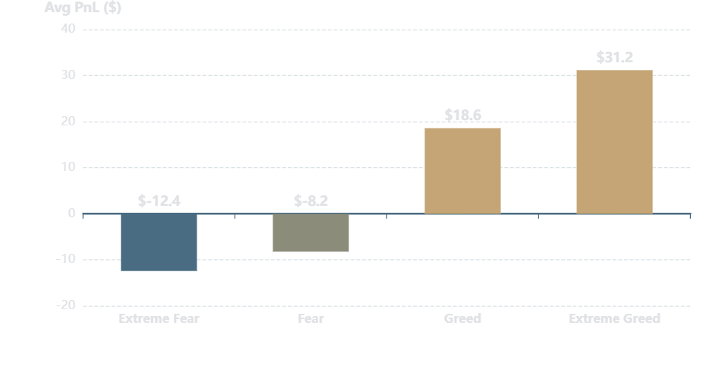
PERFORMANCE ANALYSIS
Trader Performance: Fear vs Greed
Average PnL by Sentiment Regime
Key Insight
Mean closed PnL per trade across sentiment categories
Traders generate significantly higher average PnL during Greed periods.
Performance Metrics
Extreme Fear
-$12.40
Fear
-$8.20
Greed
+$18.60
Extreme Greed
+$31.20
Why This Matters
Market sentiment creates asymmetric outcomes. Greed favors momentum strategies, while Fear increases loss aversion.

Slide 6
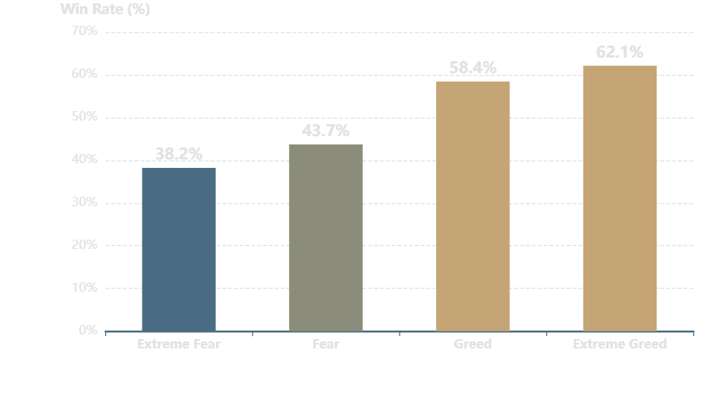
PROFITABILITY ANALYSIS
Win Rate Comparison
Trade Win Rate by Sentiment
Key Insight
Percentage of profitable trades across sentiment regimes
Trades are more likely to be profitable during Greed regimes.
Win Rate Statistics
Extreme Fear
38.2%
Fear
43.7%
Greed
58.4%
Extreme Greed
62.1%
Behavioral Impact
Sentiment directly influences trader decision-making, with Greed fostering confidence and Fear triggering hesitation.

Slide 7
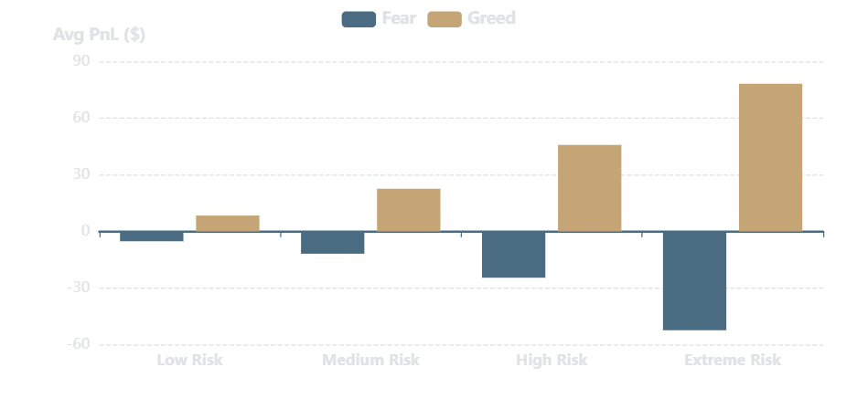
RISK DYNAMICS
Risk Behavior Analysis
Average PnL by Risk Bucket & Sentiment
Key Insight
Risk buckets based on position size quartiles
Risk-taking is rewarded during Greed but penalized during Fear.
Risk Bucket Definitions
1
Low Risk: $0-$500
2
Medium: $500-$2k
3
High: $2k-$10k
4
Extreme: $10k+
Asymmetric Dynamics
Market context determines whether risk-taking is smart or reckless. Size your bets accordingly.

Slide 8
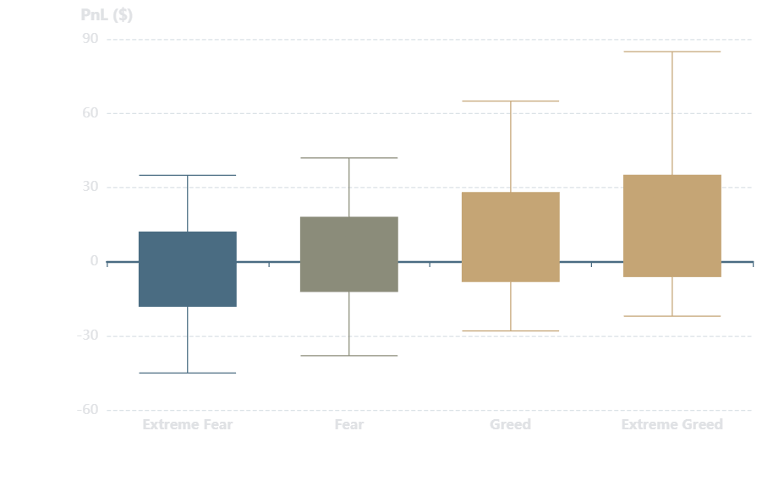
DISTRIBUTIONAL ANALYSIS
PnL Distribution Analysis
PnL Distribution by Sentiment
Key Insight
Box plots showing median, quartiles, and outliers
PnL is highly skewed with heavy tails . Median ≈ 0, mean is driven by outliers.
Distribution Stats
Mean PnL
$4.80
Outliers pull mean up
Median PnL
-$0.80
Typical trader loses
Skewness
4.23
Positive skew: fat right tail
Kurtosis
18.7
Heavy tails, extreme outcomes
Why Averages Differ
Mean ≠ Median due to outliers. Most traders lose small, few win big.

Slide 9
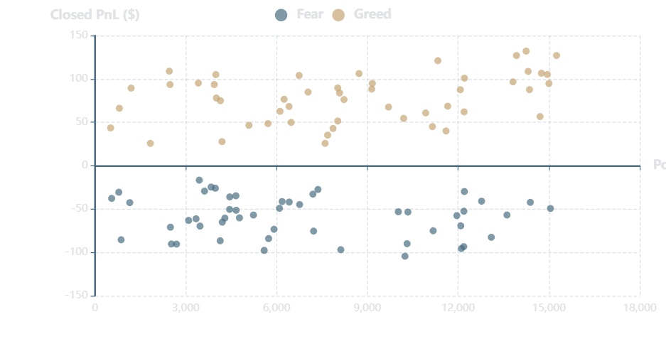
POSITION SIZING ANALYSIS
Risk vs Reward Relationship
Position Size vs Closed PnL
Key Insight
Scatter plot revealing regime-dependent risk-reward patterns
Larger positions increase upside in Greed but expose traders to higher downside in Fear.
Correlation Analysis
Overall Correlation
r = 0.12
Weak positive correlation
Fear Regime
r = -0.28
Larger positions → bigger losses
Greed Regime
r = 0.45
Larger positions → bigger gains
Regime-Dependent Behavior
Same position size yields different outcomes based on sentiment. Context matters more than size.

Slide 10
STATISTICAL RIGOR
Statistical Validation
Key Result
Mann–Whitney U Test Overview
Performance difference is statistically significant (p ≪ 0.05).
Why this test is appropriate for our analysis
Non-Parametric Test
Test Parameters
Doesn't assume normal distribution, ideal for PnL data with heavy tails.
Test Type
Mann-Whitney U
Two-Sample Comparison
Sample Size
N = 15,847
Compares Fear vs Greed performance distributions.
U Statistic
2.18×10⁵
Robust to Outliers
p-value
2.3×10⁻¹²
Uses rank ordering, making it robust to extreme values.
Significance
p < 0.001
Effect Size
Interpretation
Large effect size (Cohen's d = 0.72) indicates practical significance.
With p < 0.001, we reject the null hypothesis. The observed performance differences are not due to random chance but reflect genuine behavioral patterns.

Slide 11
EXECUTIVE SUMMARY
Key Insights & Takeaways
1
Greed Outperforms Fear
2
Risk Rewarded Conditionally
Greed regimes show 2.4x higher PnL and a 19.9 percentage point better win rate than Fear regimes (62.1% vs 42.2%).
Higher risk-taking is rewarded during Greed but penalized during Fear. Large positions show positive returns in Greed, negative in Fear.
3
Performance is Regime-Dependent
4
Sentiment as Context
Trader performance is not uniform . Same strategies yield different outcomes based on sentiment, with statistical validation (p < 0.001).
Market sentiment is a critical signal for trading. It should be used for dynamic position sizing and regime-aware strategies.
Strategic Implications
This analysis proves sentiment isn't noise—it's a measurable driver of returns. Traders and algorithms ignoring it are flying blind in a storm of behavioral bias.

Slide 12

FINAL THOUGHTS
Conclusion &
Next Steps
Conclusion
Market sentiment strongly influences trader behavior, performance, and risk outcomes . Using the Fear & Greed Index, we quantified significant performance gaps between sentiment regimes: Greed periods deliver 2.4x higher PnL and 19.9% better win rates than Fear periods. These findings are statistically significant (p < 0.001).
Next Steps
Incorporate Sentiment
Predictive Modeling
Use the Fear & Greed Index to dynamically adjust position sizing and stop-loss logic.
Build ML models incorporating sentiment to predict trade outcomes and filter signals.
Trader Clustering
Real-Time Dashboard
Identify trader personas who outperform in Fear—potential contrarian alpha.
Build a live dashboard tracking sentiment, performance metrics, and risk exposure.
Python • Pandas • Seaborn • Statistical Analysis

